Slide 1
Phases of Compilation
Ch1 p2
Dr G Sudha Sadasivam

Slide 2
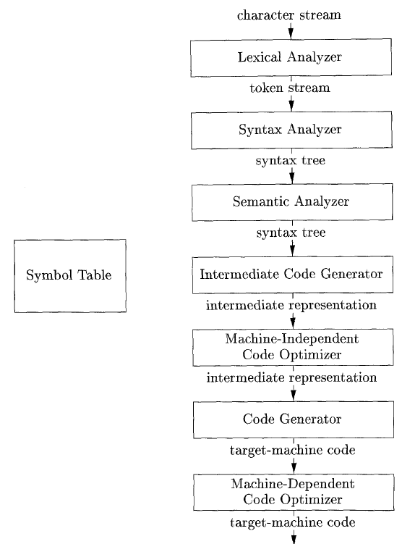
Error handler

Slide 3
Lexical Analysis (scanner)/ linear analysis The first phase of a compiler
Lexical analyzer reads the stream of characters making up the source program and groups the characters into meaningful sequences called lexeme
For each lexeme, the lexical analyzer produces a token of the form that it passes on to the subsequent phase, syntax analysis
(token-name, attribute-value)
Token-name: an abstract symbol is used during syntax analysis, an
attribute-value: points to an entry in the symbol table for this token.

Slide 4
Example: position =initial + rate * 60
1.”position” is a lexeme mapped into a token (id, 1), where id is an abstract symbol standing for identifier and 1 points to the symbol table entry for position. The symbol-table entry for an identifier holds information about the identifier, such as its name and type.
2. = is a lexeme that is mapped into the token (=). Since this token needs no attribute-value, we have omitted the second component. For notational convenience, the lexeme itself is used as the name of the abstract symbol.
3. “initial” is a lexeme that is mapped into the token (id, 2), where 2 points to the symbol-table entry for initial.
4. + is a lexeme that is mapped into the token (+).
5. “rate” is a lexeme mapped into the token (id, 3), where 3 points to the symbol-table entry for rate.
6. * is a lexeme that is mapped into the token (*) .
7. 60 is a lexeme that is mapped into the token (60)
Blanks separating the lexemes would be discarded by the lexical analyzer.

Slide 5

Syntax Analysis (parser) / hierarchical analysis The second phase of the compiler
The parser uses the first components of the tokens produced by the lexical analyzer to create a tree-like intermediate representation that depicts the grammatical structure of the token stream.
A typical representation is a syntax tree in which each interior node represents an operation and the children of the node represent the arguments of the operation

Slide 6
Syntax Analysis Example
Pay := Base + Rate* 60
The seven tokens are grouped into a parse tree
Assignment stmt
identifier
expression
:=
pay
expression
expression
+
identifier
Rate*60
base

Slide 7
Semantic Analysis: Third phase of the compiler
The semantic analyzer uses the syntax tree and the information in the symbol table to check the source program for semantic consistency with the language definition.
Gathers type information and saves it in either the syntax tree or the symbol table, for subsequent use during intermediate-code generation.
An important part of semantic analysis is type checking, where the compiler checks that each operator has matching operands. For example, many programming language definitions require an array index to be an integer; the compiler must report an error if a floating-point number is used to index an array.
The language specification may permit some type conversions called coercions. For example, a binary arithmetic operator may be applied to either a pair of integers or to a pair of floating-point numbers. If the operator is applied to a floating-point number and an integer, the compiler may convert or coerce the integer into a floating-point number.

Slide 8
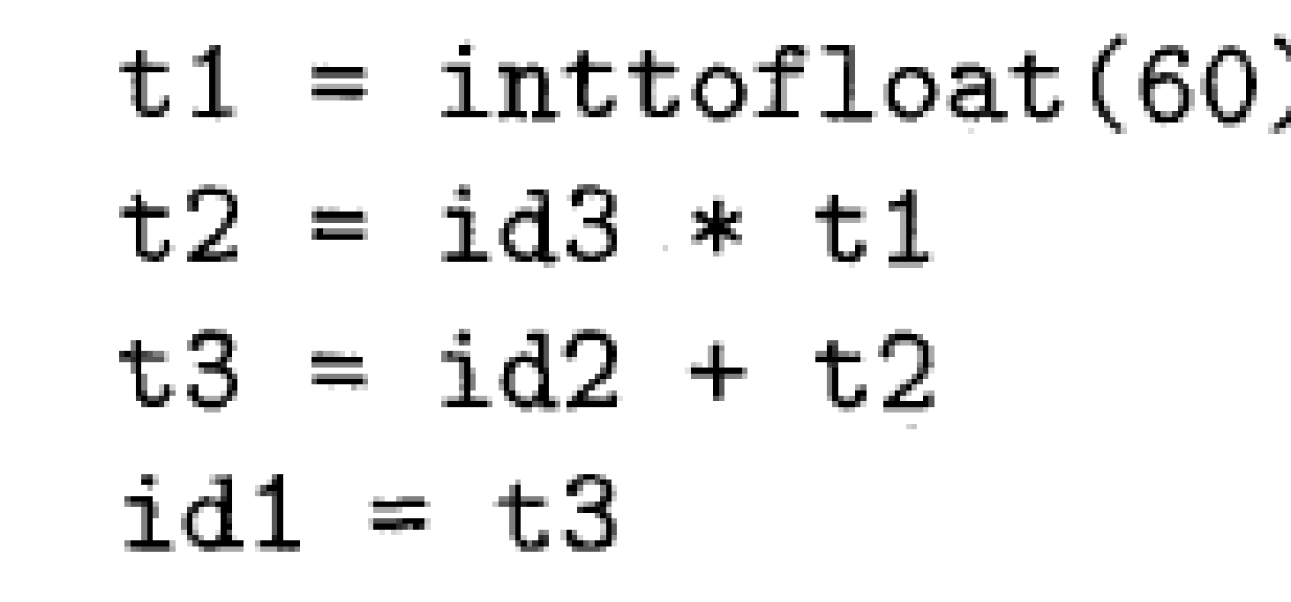
Intermediate Code Generation: three-address code Stage 4
After syntax and semantic analysis of the source program, machine-like intermediate representation is generated. This intermediate representation should have two important properties:
it should be easy to produce and
it should be easy to translate into the target machine.
The considered intermediate form called three-address code, which consists of a sequence of assembly-like instructions with three operands per instruction. Each operand can act like a register.

Slide 9
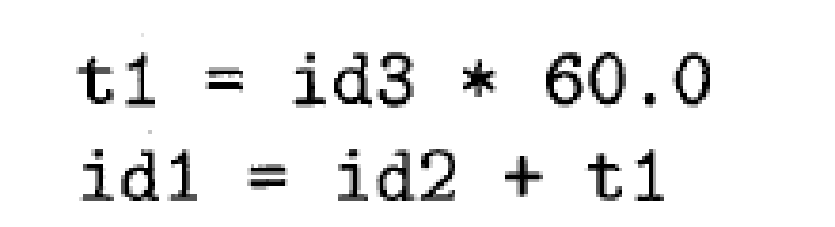
Code Optimization: to generate better target code Stage 5
The machine-independent code-optimization phase attempts to improve the intermediate code so that better target code will result (speed and size)
Usually better means:
faster, shorter code, or target code that consumes less power.
The optimizer can deduce that the conversion of 60 from integer to floating point can be done once and for all at compile time, so the int to float operation can be eliminated by replacing the integer 60 by the floating-point number 60.0. Moreover, t3 is used only once
Optimisation improves running time of the program (exe)

Slide 10
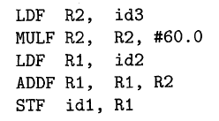
Code Generation – stage 6
takes as input an intermediate representation of the source program and maps it into the target language
If the target language is machine code, registers or memory locations are selected for each of the variables used by the program.
Then, the intermediate instructions are translated into sequences of machine instructions that perform the same task.
A crucial aspect of code generation is the judicious assignment of registers to hold variables.

Slide 11
Target code optimisation
It improves the target code generated by choosing proper addressing modes to improve the performance, replacing slow instructions by fast ones and eliminating redundant instructions
MUL R2, #2.0 by SHL R2

Slide 12
Symbol-Table Management:
The symbol table is a data structure containing a record for each variable name, with fields for the attributes of the name.
The data structure should be designed to allow the compiler to find the record for each name quickly and to store or retrieve data from that record quickly
These attributes may provide information about the storage allocated for a name, its type, its scope (where in the program its value may be used), and in the case of procedure names, such things as the number and types of its arguments, the method of passing each argument (for example, by value or by reference), and the type returned.

Slide 13
Error Handling
One of the most important functions of a compiler is the detection and reporting of errors in the source program. The error message should allow the programmer to determine exactly where the errors have occurred.
Errors may occur in all or the phases of a compiler.
Whenever a phase of the compiler discovers an error, it must report the error to the error handler, which issues an appropriate diagnostic message.
Errors should also be corrected automatically to continue compilation process
Both of the table-management and error-Handling routines interact with all phases of the compiler

Slide 14
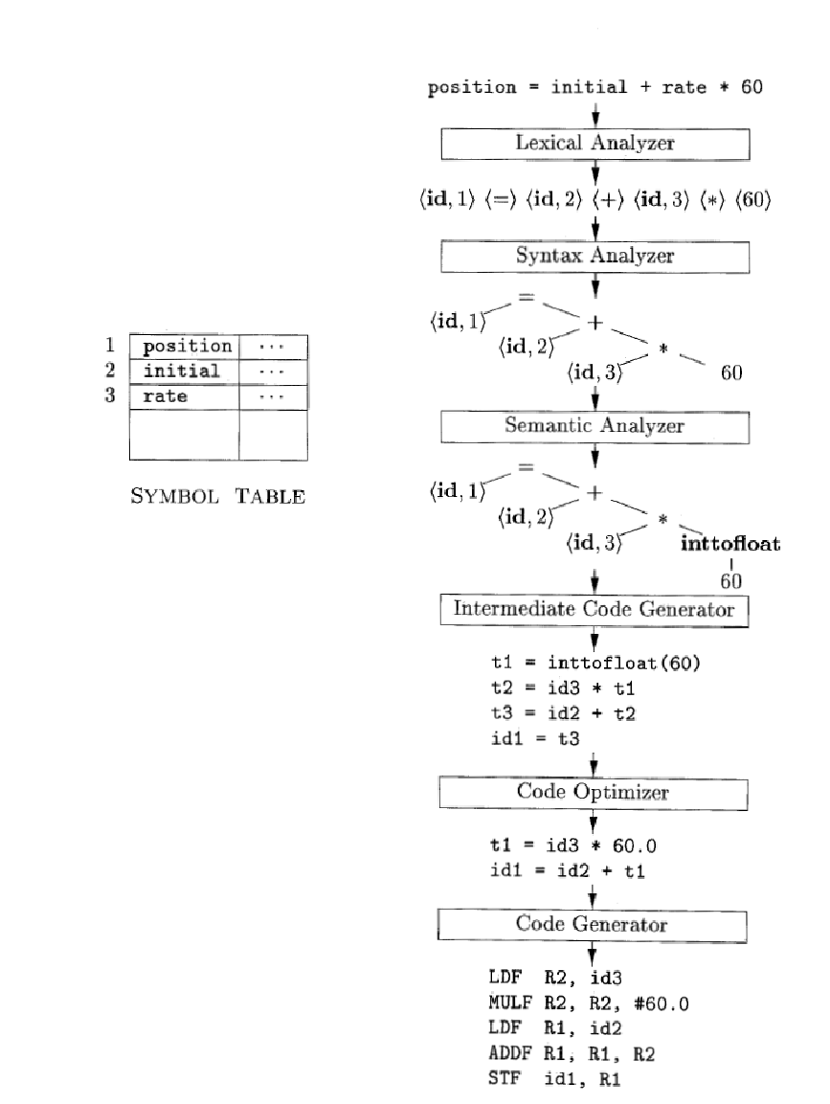
Translation of an assignment statement

Slide 15
Example 2
newval := oldval + 12
a[i]=4+2+I;

Slide 16
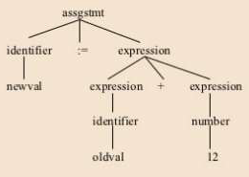
Tokens:
newval Identifier
= Assignment operator
oldval Identifier
+ Add operator
12 Number

Slide 17
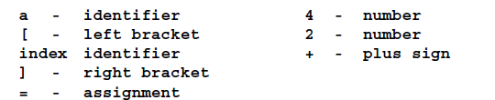
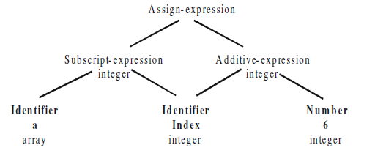

Slide 18
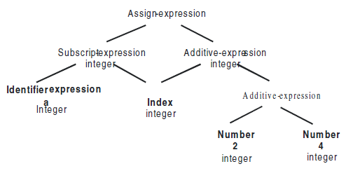



Slide 19
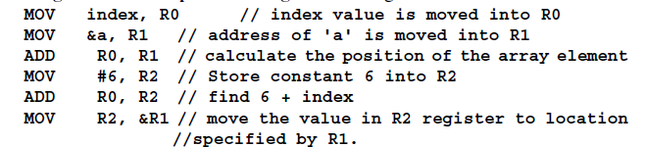
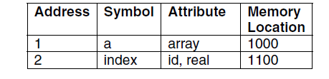
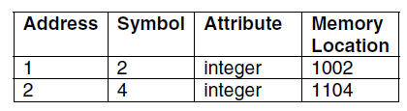

Slide 20
{
float out,a1,a2;
int a,b,c;
a1=b+c;
a2=a;
if (a1<a2) then
out = a2;
else
out= a1;
}

